Slide 1
HW4
Bitcoin Miner
Parallel Programming
2025/10/31

Slide 2
Spec
In this assignment, you are going to parallelize a bitcoin miner with CUDA. You may use any techniques that you’ve learned in this class!
Please refer to the assignment’s specification for detailed information about the assignment.

Slide 3
What is Blockchain?
A blockchain is essentially a sequence of verified blocks
  Each block contains the information of transactions and metadata, including the hash value of its previous block.
  Due to the property of cryptographic hash function, If something is modified, it will be discovered immediately.
Block N-1
Block N
Block N+1
Header
Header
Header
Timestamp
Timestamp
Timestamp
Previous Hash
Previous Hash
Previous Hash
Merkle Root
Merkle Root
Merkle Root
Nonce
Nonce
Nonce
Transactions N-1
Transactions N
Transactions N+1

Slide 4
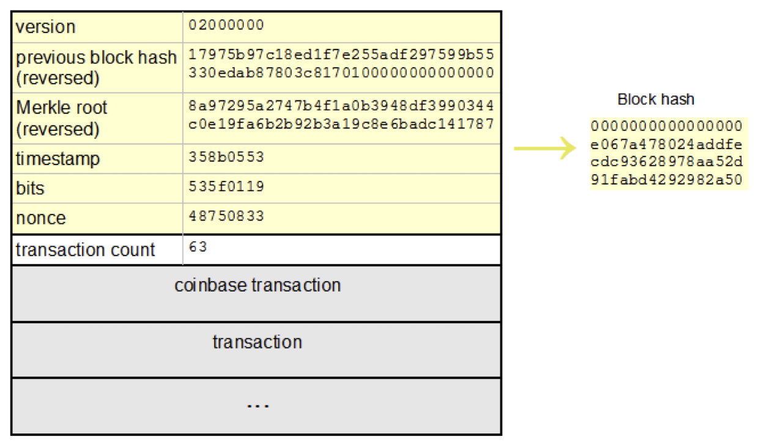
What is Block?
A block is a data structure containing the information of transactions and metadata. It consists of two parts:
  Block Header
    Version number
    Hash of the previous block
    Merkle root
    Timestamp
    Target Difficulty (encoded in Bits)
    Nonce
  Block Body
    Transaction counter
    List of transaction records
    …

Slide 5
Job of Bitcoin Miner
The job of a miner is to create and add blocks to the blockchain by following steps:
Gather transactions
Create the block header
Find the proper nonce
Broadcast the block
Receive rewards
hash < Target Difficulty

Slide 6
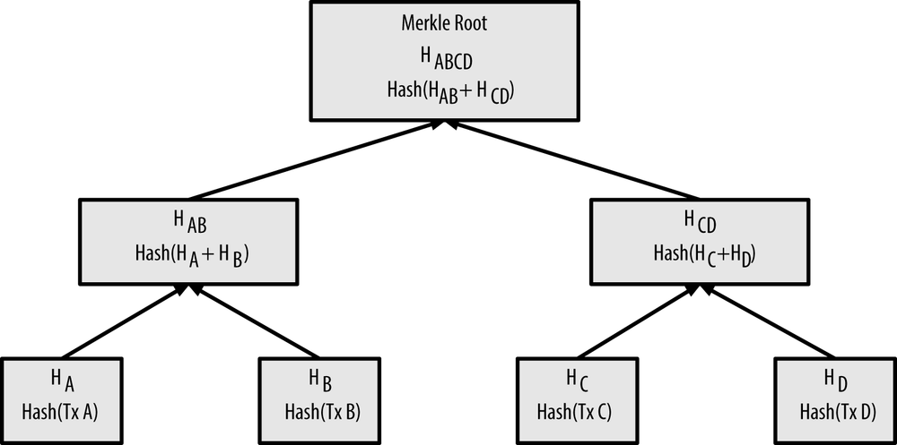
What is Merkle Tree?
A Merkle tree is a binary tree in which every leaf node is the hash of a data block, and every inner node is the hash its children. Merkle tree allows efficient and secure verification of the contents of a large data structure.
H_{A} = SHA256(SHA256(TxA))
H_{B} = SHA256(SHA256(TxB))
H_{AB} = SHA256(SHA256(H_{A}+H_{B}))
Credit: https://www.oreilly.com/library/view/mastering-bitcoin/9781491902639/ch07.html

Slide 7
Node Generation
Each parent node is generated by double SHA-256 function
Each child node is hashed by SHA-256 TWICE.
The results (HA and HB) are summed together.
The sum is then hashed AGAIN by SHA-256 TWICE.
The procedure is repeated again and again, until the root node is reached
H_{A} = SHA256(SHA256(TxA))
H_{B} = SHA256(SHA256(TxB))
H_{AB} = SHA256(SHA256(H_{A}+H_{B}))

Slide 8
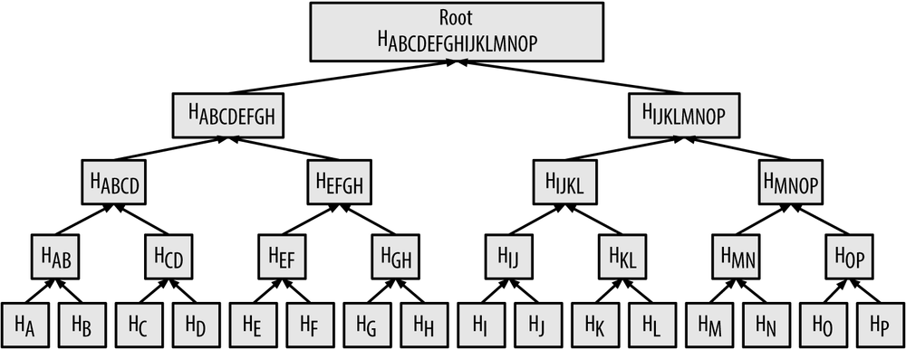
Merkle Root
The root is called Merkle root. It represents the entire data set, and any change in the data would result in a different Merkle root.
Credit: https://www.oreilly.com/library/view/mastering-bitcoin/9781491902639/ch07.html

Slide 9
Target Difficulty
Purpose: to maintain a consistent block generation rate and ensure that the blockchain remains secure and stable.
The Target Difficulty is a value to determine how difficult it is to find out a proper hash for the block header by requiring hash < Target Difficulty.
The Target Difficulty conforms to the following rules
  It is a 256-bit number, encoded by a field called “bits” (in 4 bytes)
  It has N leading zeros. Currently, N equals 76 (year 2022).
  It is determined by the Bitcoin network.
  It is adjusted such that a new block is computed every 10 minutes (on average)
  You may check current difficulty here: https://btc.com/stats/diff

Slide 10
Nonce
Nonce is a 32-bit value in the block header.
Miner needs to find a proper nonce such that the hash of the block header is less than the current Target Difficulty.
Block header hash < Target Difficulty

Slide 11
Goal of the Assignment
Find a proper nonce for a given block
  The hash of the block header has to be less than the given Target Difficulty.
  The time you spent on finding the hash value has to be accelerated.
  Use any techniques that you’ve learned in this class!

Slide 12
Sequential Code
Read input.
Calculate the merkle root from transactions.
Decode the Target Difficulty.
Find a proper nonce, such that the hash value of the block header satisfies the requirement.
for nonce = 0X00000000 to 0Xffffffff
calculate a hash value
if the hash value < Target Difficulty
done

Slide 13
Sequential Code - Header Extraction
Step 1 : Read input
There are several fields in the block header that you have to extract.
// **** read data *****
char version[9];
char prevhash[65];
char ntime[9];
char nbits[9];
int tx;
char *raw_merkle_branch;
char **merkle_branch;
getline(version, 9, fin);
getline(prevhash, 65, fin);
getline(ntime, 9, fin);
getline(nbits, 9, fin);
fscanf(fin, "%d\n", &tx);
printf("start hashing")
raw_merkle_branch = new char [tx * 65];
merkle_branch = new char *[tx];
for(int i=0;i<tx;++i) {
merkle_branch[i] = raw_merkle_branch + i * 65;
getline(merkle_branch[i], 65, fin);
merkle_branch[i][64] = '\0';
}

Slide 14
Sequential Code - Header Fields
A representative header fields of a block is depicted below
  Please have a comparison with pages 4.
  These information has to be extracted first before we carrying out the calculation.
case01.in
4
20000000
0000000000000000003348540cbfc68b70825e7abcd5a83a48a5f87fa7f1aace
5ac22f8b
17502ab7
2094
c6574adb277efbfb972658ab78b1277707a967076cfc90d6af800cd8a915396d
c01c33240ba97fb6db2b98fbaf7e4211fe3b59585372994bdac1b96b1c9be0d3
abce7b2b30ff62b4998864db6a1ea77db8eb33d3f6abe3f981e0d2802c999042
fd463aca59df1302c8f08e8070b56bd64ebe0cf35ba68cd5b39d208a2ff50053
4321318516cb6630e3b3caa29bd49227168a69d170e1110c220b3c30d15f913c
f1f452e09dad935a67499a24e388d61fd7f0f38c97a2a92c73b2fd7019a85578
dd24a8e3f419006cd2f7cb3336b605fa6c2898accecac3d0a844c2ae8f5f53d9
Number of blocks
Version
Previous block hash
Timestamp
Bits (packed difficulty)
Number of transactions
Transactions

Slide 15
Sequential Code - Merkle Root
Step 2：Calculate the merkle root from transactions
  The merkle root is calculated by a function provided by the TA
  You are encouraged to take a look of its implementation
// **** calculate merkle root ****
unsigned char merkle_root[32];
calc_merkle_root(merkle_root, tx, merkle_branch);
printf("merkle root(little): ");
print_hex(merkle_root, 32);
printf("\n");
printf("merkle root(big): ");
print_hex_inverse(merkle_root, 32);
printf("\n");

Slide 16
Sequential Code - Target Difficulty
Step 3：Decode the Target Difficulty
  It is decoded from a number called nbits.
  The decode algorithm is already implemented by us (shown below).
  If you are interested in that algorithm, please take a look of this website.
// ********** calculate target value *********
// calculate target value from encoded difficulty which is encoded on "nbits"
unsigned int exp = block.nbits >> 24;
unsigned int mant = block.nbits & 0xffffff;
unsigned char target_hex[32] = {};
unsigned int shift = 8 * (exp - 3);
unsigned int sb = shift / 8;
unsigned int rb = shift % 8;
Example:
  Bits: 0x1709f8d9
  Target = 0x09f8d9 * 2 ** (8 * (0x17 - 3))
= 0x00000000000000000009f8d90000000000000000000000000000000000000000

Slide 17
Sequential Code - Nonce
Step 4 : Find a proper nonce, such that the hash value of the block header satisfies the requirement
  Try if you can figure out a way to parallelize and accelerate the code.
for(block.nonce=0x00000000; block.nonce<=0xffffffff;++block.nonce){
//sha256d
double_sha256(&sha256_ctx, (unsigned char*)&block, sizeof(block));
if(block.nonce % 1000000 == 0) {
printf("hash #%10u (big): ", block.nonce);
print_hex_inverse(sha256_ctx.b, 32);
printf("\n");
}
if(little_endian_bit_comparison(sha256_ctx.b, target_hex, 32) < 0) { // sha256_ctx < target_hex
printf("Found Solution!!\n");
printf("hash #%10u (big): ", block.nonce);
print_hex_inverse(sha256_ctx.b, 32);
printf("\n\n");
break;
}
}

Slide 18
Sequential Code - SHA-256
SHA-256 implementation for the sequential version can be found at:
  sha256.h
  sha256.cu
If you are interested in the implementation details, please take a look at the following website
  https://en.wikipedia.org/wiki/SHA-2

Slide 19
Test cases
We provide several test cases for you to test your program
The execution time of the sequential code are given below:
  case00.in : about 1 hr 15 min
  case01.in : about 1 hr 15 min
  case02.in : about 30 min
  case03.in : about 11 min
Please keep in mind that your goal is to parallelize the mining algorithm and accelerating it.
It has to be faster than the sequential version.

Slide 20
Grading
Correctness (50%)
  Please make sure to use GPU and verify your answer.
Performance (20%)
  We will grade the performance of your assignments against the other students in the class.
Report (30%)
  Please describe, in detail, how you parallelize your codes as well as your optimization methodology.
Advanced CUDA skills
  You are welcome to use streaming, page-lock memory, asynchronous memory copy, or any other advanced skills.
Others
  You will get credits if you are able to optimize the other parts of the source codes. Please justify your solutions and provide a detailed comparison in your report.

Slide 21
Grading - Report
In your report, please include the following parts:
  Describe the design/overview of your implementation briefly.
  The parallelization and optimization techniques you used in your solution
  Experiments of various combinations of the number of blocks & threads (at least 8 combinations) and plot them with the figures
  Describe the details if you use advanced CUDA skills
  (Optional) Any suggestions or feedback for the homework is welcome

Slide 22
Submission
Please zip the following files to a single archived file named <StudentID>.tar:
  hw4.cu
  sha256.cu
  sha256.h
  report.pdf
  Makefile (optional)
Please make sure your Makefile works properly (Your Makefile should build executable binary hw4) and your program can run before submitting your assignment 4.

Slide 23
Reminder
Because we are doing hash, there may be a situation multiple nonce can satisfies the requirement hash value < Target Difficulty.
We accept all nonce satisfies the requirement, so don’t worry if your nonce isn’t same as our provided solutions.
We ensure that all the testcases have more than one solution.
Please refer to the assignment’s specification for detailed information about the assignment.

Slide 24
Deadline
The deadline of assignment 4 is 11/14 (Fri.), 23:59.
Everyone is welcomed to ask questions on NTU cool.

